Slide 1
Account Receivables

Slide 2
Over View
Customer account group
Customer master data : BP
Posting of Invoices and Cash Receipts
Notes:
Fixar a posicao do titulo – sempre do lado esquerdo.
Sempre que tiver muito texto o coluna deve sempre ser “ narrowed” , se nao fica dificil de ler. Colocar paragrafos no texto.
Linha vertical deve ser mais fina e as pontas NUNCA devem ser arredondadas.

Slide 3
Customer Account Group
Status
The status of the fields in the master record.
Whether the account is for one – time customer or General customer.
Which fields in the customer master should be optional, required, display or suppressed.
The number range of the accounts.
Customer
Account Grp
C
O
N
T
R
O
L
S
Partner Schema
Field Selection
Number Range
Notes:
Fixar a posicao do titulo – sempre do lado esquerdo.
Sempre que tiver muito texto o coluna deve sempre ser “ narrowed” , se nao fica dificil de ler. Colocar paragrafos no texto.
Linha vertical deve ser mais fina e as pontas NUNCA devem ser arredondadas.

Slide 4
Customer Account Group
General Customer or one- time customer
Field selection
Account group determines...
Type of number
assignment
Number
assignment interval

Slide 5
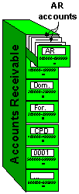
Account Group
Grouping of similar accounts in ranges. It ensures that only the relevant screens and fields are displayed and ready for input for each of the customer’s different partner functions. You maintain the account groups in Customizing (IMG), or copy the defaulted account groups.
Account Groups controls:
The number ranges of the Accounts
The status of the fields in the Master record (If fields are mandatory, suppressed, changeable)
Authorization, who is allowed to Create, Change and display Master Records
If the Account is a One Time Customer

Slide 6
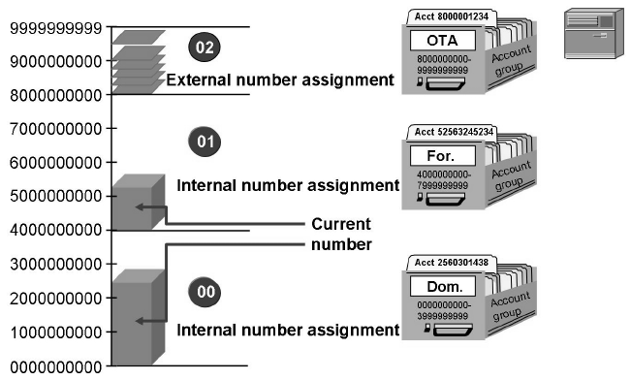
Number Ranges
The range of possible account numbers is divided into smaller number ranges. Number ranges must not overlap. For each number range you can define whether the number assignment is internal or external
Internal numbers are assigned by the system, whereas external numbers are entered by the user who creates the record. External numbers may be alphanumeric
Each number range can be assigned to one or more account groups
Notes:
Fixar a posicao do titulo – sempre do lado esquerdo.
Sempre que tiver muito texto o coluna deve sempre ser “ narrowed” , se nao fica dificil de ler. Colocar paragrafos no texto.
Linha vertical deve ser mais fina e as pontas NUNCA devem ser arredondadas.

Slide 7
Number Ranges
Internal Number Range | External Number Range
System will automatically allocate the number range within the given range, sequentially. | User has to assign externally the number, as required.
Alpha Numeric number is not possible. | Alpha Numeric number is possible.
System will give next number. | User has to select the number by checking the existing records.
Notes:
As a purchaser you negotiate with vendor for discount/rebate on a particular material volume, material range volume, total purchase price from vendor or punctual payment for a particular time period. (exp vendor will give additional rebate of 2% if total procured quantity of material A is more than 2000 PC in a year). You create a agreement with vendor for the agreed condition. You keep on ordering the material/materials from the vendor, performed good receipt and payment of vendor. Once the agreed time period is over business volume done with vendor compared with the agreed business volume. If business volume done with vendor exceed you need to settle agreed discount/rebate that is known as subsequent settlement. As the result of subsequent settlement credit memo is created against vendor.

Slide 8
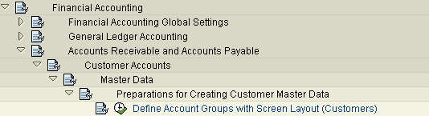
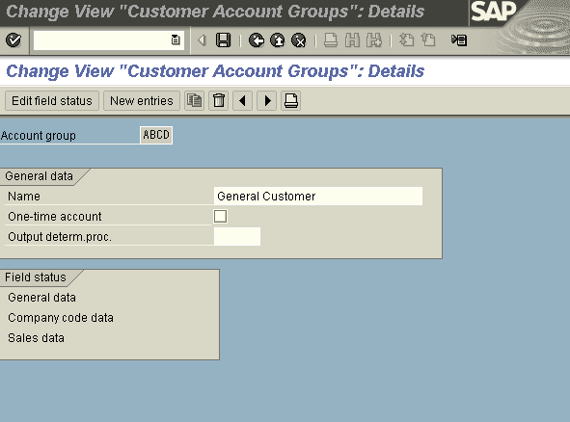
Customer Account Group
Double click General data and Follow…..steps
Field Status Group: For each activity, you can define the status of fields separately in the individual areas of a master record in the same manner as account groups:
1. General data area:
2. Company code area : These settings affect all company codes.
3. Sales area: These settings affect all sales organizations.
Notes:
In the subsequent settlement in purchasing agreed discount/rebate is settled with vendor on a material volume or material range volume or total purchase price or timely payment of invoice for a particular time period.
As the result of subsequent settlement the cost of purchased goods reduce because you negotiate better discount/rebate for a period of time.
As the result of subsequent settlement you focus on strategic purchasing decision (right quantity, right price, right quality, right time etc) for a period of time from a vendor. This improve efficiency of supply chain management.

Slide 9
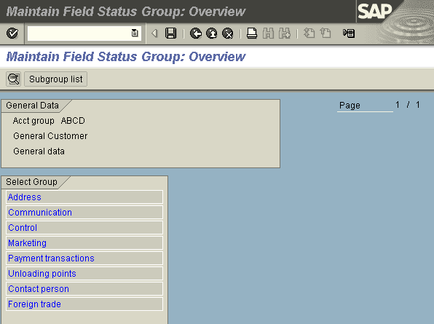
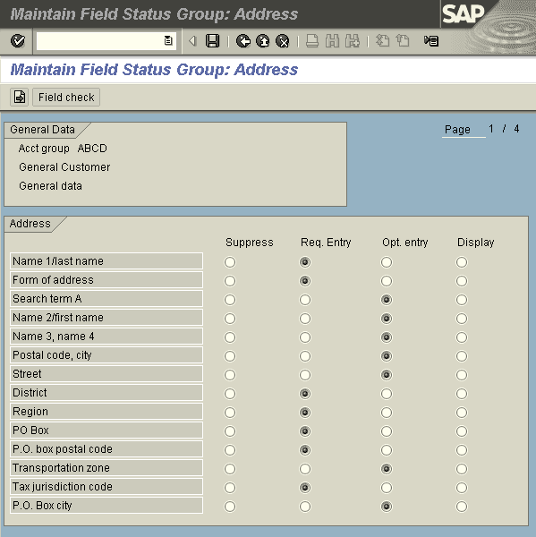
Customer Account Group
First screen displays general data: Which contains address information of customer. Second screen displays which fields are required , optional, suppressed
Notes:
The biggest challenge in subsequent settlement is the forecasting of required quantity of a material for particular time period. Because on the basis of these forecasting result you negotiate with vendor for the discount/rebate.
Another major hurdle is the keep on ordering material from the same vendor (exp. After some time vendor is not supplying material up to quality standard)
Other challenge is the timely entering good receipt and timely paying vendor invoice because on the basis of past business volume data subsequent settlement Is done.

Slide 10
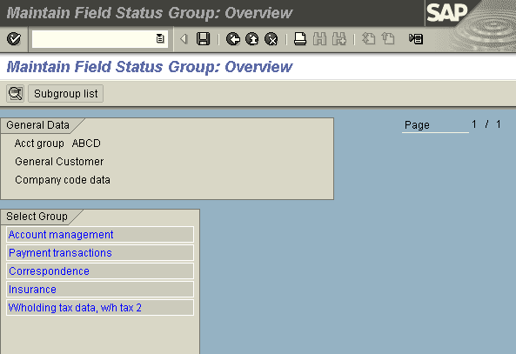
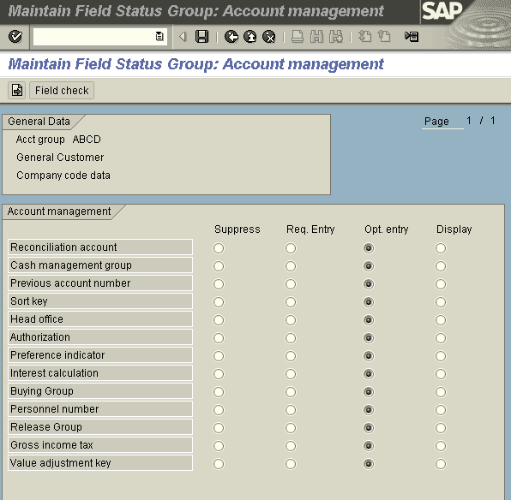
Customer Account Group
Company code data
The company code data contains Account Management, Payment transactions, Correspondence and withholding tax.

Slide 11
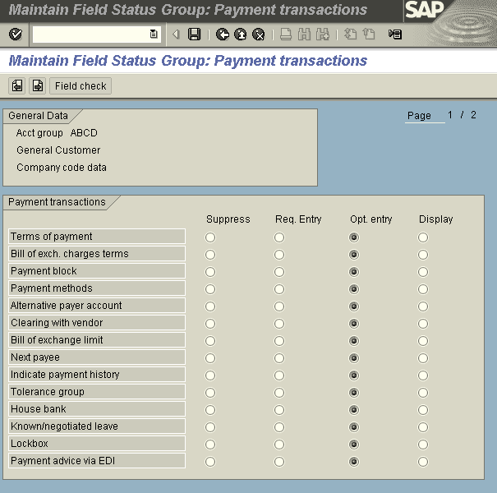
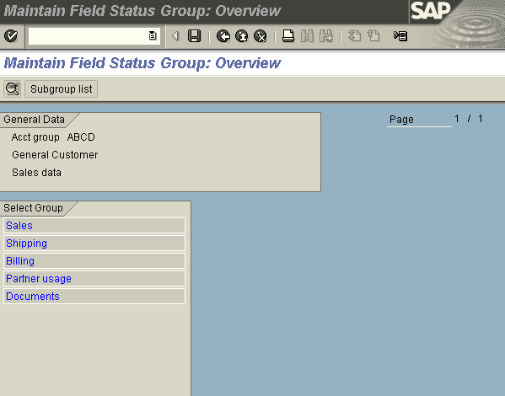
Customer Account Group
Notes:
Fixar a posicao do titulo – sempre do lado esquerdo.
Sempre que tiver muito texto o coluna deve sempre ser “ narrowed” , se nao fica dificil de ler. Colocar paragrafos no texto.
Linha vertical deve ser mais fina e as pontas NUNCA devem ser arredondadas.

Slide 12

Customer Master Data
The Customer Master includes all data necessary for processing business transactions and corresponding with customer
Information is shared between the accounting and sales departments
Data is grouped into three categories:
General data
Company code data
Sales data
Customer Master Data
General data
Company code data
Sales Org data
Notes:
As a a purchaser you negotiate long term rebate/discount with vendors for the purchase of particular material or ranges of materials or services or punctual payment of vendor invoices or running promotions or contribution to the costs incurred in retail (for example, disposal costs). You create an agreement with vendor with agreed condition for a particular time period in the system. As the requirement comes purchase orders created with vendor. Good receipts or service entry sheet is entered in the system as soon as the material received or service performed by the vendor. Vendor raises the invoice , purchaser/central clerks verify and enter the invoice by using logistic invoice verification functionality. At the time of invoice verification system checks that the conditions in the purchase order is need to settle immediately. If condition need to settle immediately then system settle at the time of invoice verification otherwise update vendor business volume. At the end of agreement period or partial condition settlement time vendor business volume compared with vendor data. If there is any difference then agree on common business volume data with vendor and settle account.

Slide 13
Customer Master Data
The accounting department uses some data which remains unchanged for long periods of time and which is often referred to by other data. This data is called master data
Customer Master Data
IN FI, master data is includes general ledger and sub ledger accounts , as well as bank master records
The master record contains data that controls how business transactions are recorded and processed by the system. It also includes all the information about a customer that you need to be able to conduct business with him
The Accounts Receivable application component records and manages accounting data for all customers. It is also an integral part of the sales system

Slide 14
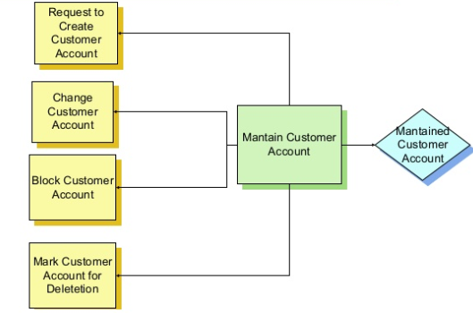
Master Data Activity Flow

Slide 15
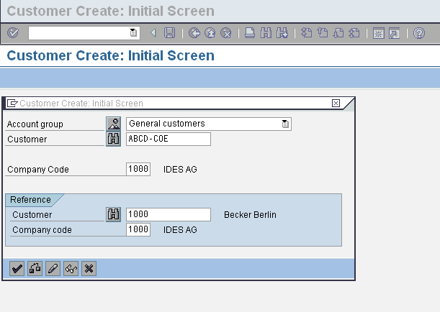
Customer Master Data

Slide 16
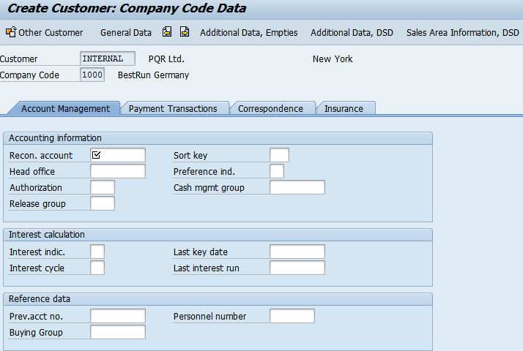
Customer Master Data

Slide 17
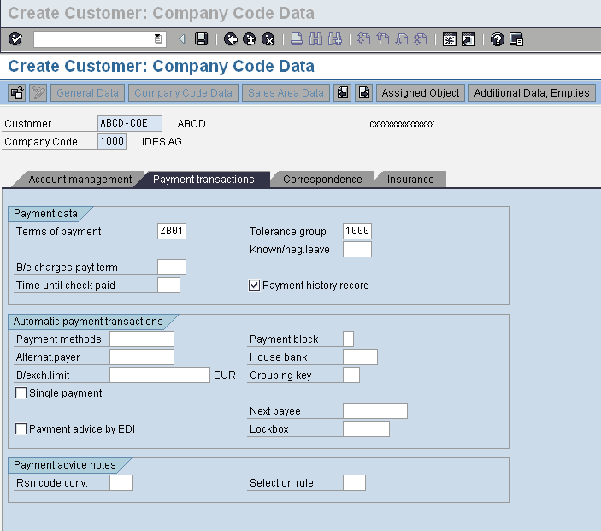
Customer Master Data
Notes:
Periodic conditions are settled at the end of period. At the end of specific period rebate/discount is calculated on the total business volume done with vendor in that particular period. In final settlement total business volume done with vendor during the arrangement period is calculated (volume which are already settled periodically also consider) and rebate/discount is calculated as per main condition. The rebate/discount that is achieved in periodic settlement is deducted from total rebate/discount and remaining amount is settle as the final settlement.
In the above example
In Q1(Jan to Mar) total business volume =$9400 Hence rebate/discount= 9400*0.02=$188
In Q2(April to Jun) total business volume =$11800 Hence rebate/discount= 11800*0.02=$236
In the total arrangement period (jan to Jun) total business volume= $21200. As the process of final settlement this volume in the range of discount 3%
Hence total rebate/discount=21200*0.03=$636. As $235 and $188 are already settled in periodic settlement
hence final settlement rebate/discount =636-236-188=$212.

Slide 18
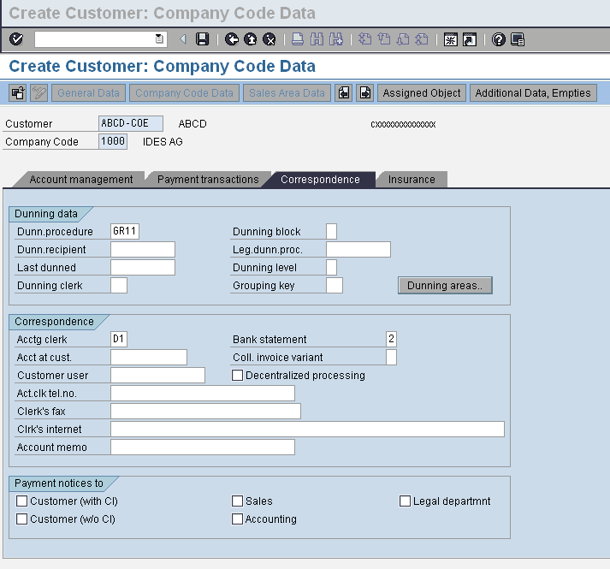
Customer Master Data
Notes:
Prerequisites for any type of settlement is that condition should be due for settlement and all business volume data should be updated.
All periodic conditions at the end of period are settle at the end of period by partial settlement. There is no updation of business volume data is possible in condition record once conditions are settled.
At the time of final settlement (at the end of rebate arrangement validity period) all business volume data (which are due for settlement or which already settle in partial settlement or in interim settlement) are consider. Total Rebate/Discount is calculated on total business volume data on the basis of main condition and rebate/discount which is already settle in partial or interim settlement is deducted from total rebate/discount. Remain amount is settle as final settlement. Once final settlement is done it is not possible to update any business volume.
Conditions entered in the rebate arrangement is used in price determination at the time of purchase order creation.
It is possible to settle conditions that are due to settle at the end of certain period , before the end of period. Example certain conditions are due to settle at the end of Q3 (31st Sept 2007) but due to some reason you want to settle on 15th Aug. In this case business volume done up to 15th Aug is consider and putting settlement date 31st Sept rebate/discount is settled. It is possible to update business volume after settlement. Remaining business volume consider at the time of partial or final settlement.

Slide 19
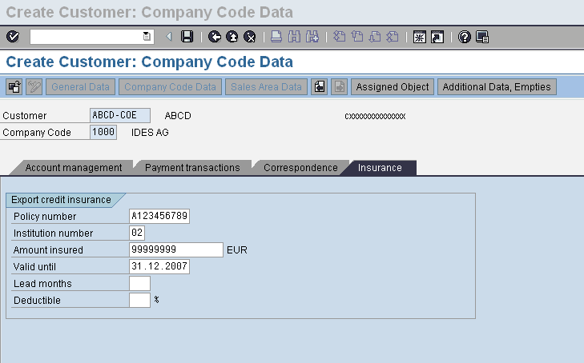
Customer Master Data:
Notes:
Rebate arrangement is the combination of conditions which are applied on good or vendor sub range or organizational unit. These conditions can be one time condition or periodic condition. Each rebate arrangement has arrangement type which controls validity period of arrangement, settlement calendar, payment method, allowed conditions, settlement type (debit side or credit side) and area of application of condition.
Before creating rebate arrangement in system “subsequent settlement “ indicator must be set in vendor master record. Material must be present in the system. Condition with all necessary information (exp area of application and settlement frequency) must be created.
It is possible to extend existing rebate arrangement to increase validity period.

Slide 20

Master Data
Notes:
Retrospective rebate arrangement is created when discount or rebate negotiated with vendor after doing some business and the previous business volume also considered under these rebate/discount conditions.
Example you agreed with vendor for periodic rebate of 2% every quarter w.e.f 01.01.2007 on 01.04.2007 . You create rebate arrangement in system on 02.04.2007. But before creating rebate arrangement following is the situation of business volume done with vendor
PO of value $ 100 is created on 20.01.2007
.
.
Po of value $ 150 is created on 01.04.2007
For all these above PO’s rebate conditions are not taken in price determination and condition record is not updated. Hence after creating rebate arrangement need to update condition record subsequently.
PO created after 02.04.2007 will include rebate condition in price determination and update condition record at Po creation time.

Slide 21
Customer (Business Partner) Master Data
In Traditional ERP, we have Customer and Vendor as different object
For Customer, we have following views:
General
Finance
Sales
For creating there objects we need different Transaction code:
Customer: XD01, FD01, VD01
In S4 HANA both customer and vendor get created with Transaction BP
Notes:
Business volume done with vendor is updated by money value or quantity or weight or volume at the time of PO/GR/IR. In all cases business volume updated by money value.
In case of updating at PO time business volume update at delivery date. Condition record updated for valid conditions at the PO creation time.
In case of updating at GR time business volume update on document date. Time independent condition in Po use as the basis of business volume update. If Good receipt date is described as pricing date category then new price determination carried out at GR time and business volume data updated.
In case of invoice receipt time business volume data updated on invoice receipt date either by verified invoice data or by PO data.
In all the case business volume data updated for good as well as on organization level in all the currency specified in arrangement for main rebate condition, rebate arrangement currency or scale currency and in all units.
Note Business volume data is not updated for consignment process, pipeline procurement, credit memo or invoice without purchase order.

Slide 22
Customer Master Data: BP
A Business Partner can be a person, organization, group of people, or a group of organizations, in which a company has a business interest. It is the single point of entry to create, edit, and display the master data for business partners, customers and vendors. A Business Partner consists of general data like name, address, bank information, etc. as well as role specific information i.e. customer/vendor/employee data
The master record contains data that controls how business transactions are recorded and processed by the system. It also includes all the information about a customer that you need to be able to conduct business with him
The Accounts Receivable application component records and manages accounting data for all customers. It is also an integral part of the sales system:

Slide 23
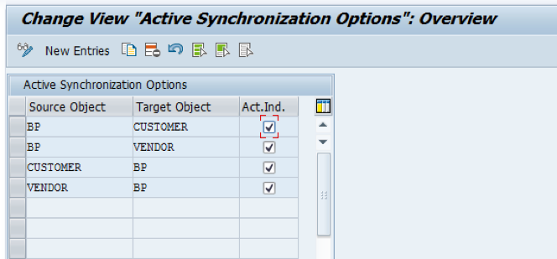
Business Partner: Customer
Activate synchronization between Business Partner and Customer/Vendor
SPRO->IMG->Cross-Application Components–> Master Data Synchronization –> Synchronization Control–> Activate Synchronization Options
Notes:
As the business volume data recorded by you and by vendor may be differ because both may have different fiscal year in this situation to avoid conflict and settle vendor account business volume comparison carried out. In business volume comparison business data compare at different aggregation level like on plant level or on vendor level or monthly business volume with vendor etc. After business volume comparison you and vendor agreed on common business volume data and settle vendor and your account in account settlement procedure.
Prerequisites for business volume comparison are:
Business volume comparison type should be define in arrangement type. It means in arrangement type it should be define whether business volume comparison is allowed or mandatory for settlement of periodic or main condition. It should also defined how to handle business volume done after business volume comparison in settlement accounting
Business volume tolerance group should be define in arrangement type and should be assign to user group. Business volume tolerance group gives th guideline to compare business volume for periodic or main condition.
It should be define in arrangement type at which level business volume data should be entered.

Slide 24
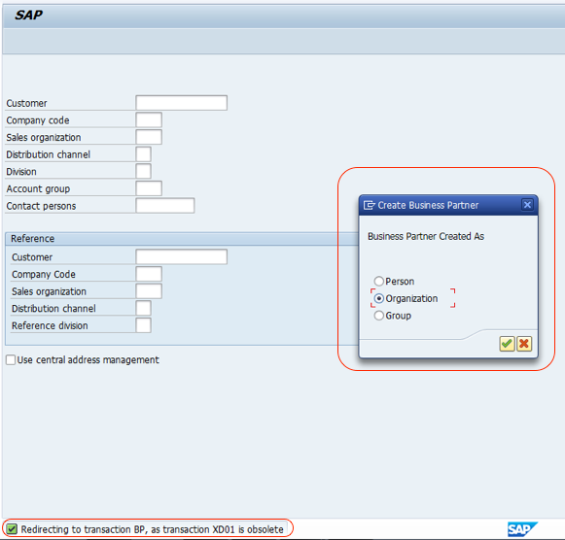
Business Partner: Customer
In S4 HANA when you enter T code XD01 it will redirect to BP transaction, a prompt will come that will ask you to choose Person, Organization and Group
Notes:
After business volume comparison rebate arrangement is settle by account settlement function. In account settlement rebate income is distributed among different organization level. In this process vendor account is credit and company account is debited and relevant accounting document generated. If rebate arrangement is made for customer then customer account is debited.
Settlement account is carried out at plant level or purchase organization level. In plant level account settlement rebate income distributed among plants by share of business volume or evenly. Separate accounting document generated for each company code. In purchase organization level settlement rebate income always distributed by share business volume. Account settlement document posted in the company code for which purchase organization belongs and separate accounting document created for each company code.
In account settlement rebate income is distributed to each condition required to be settled. A separate billing document created for each tax code. For example invoice posted with 16% input tax then in account settlement this 16% input tax is set off.
If some conditions are already settled during partial or interim settlement then these statistics need to be updated before final account settlement.

Slide 25
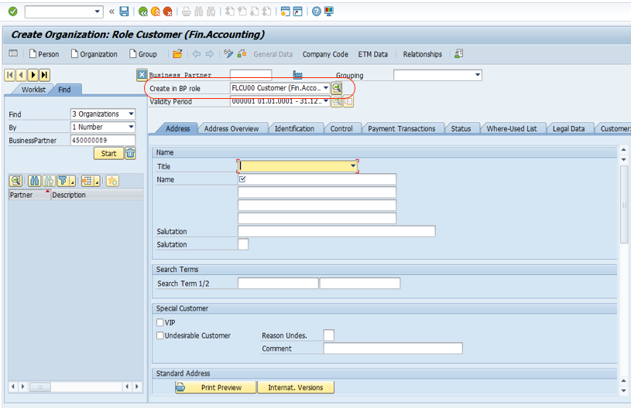
Business Partner: Customer
Here you can see that default BP role set as FLCU00 (Customer Financial Accounting)

Slide 26
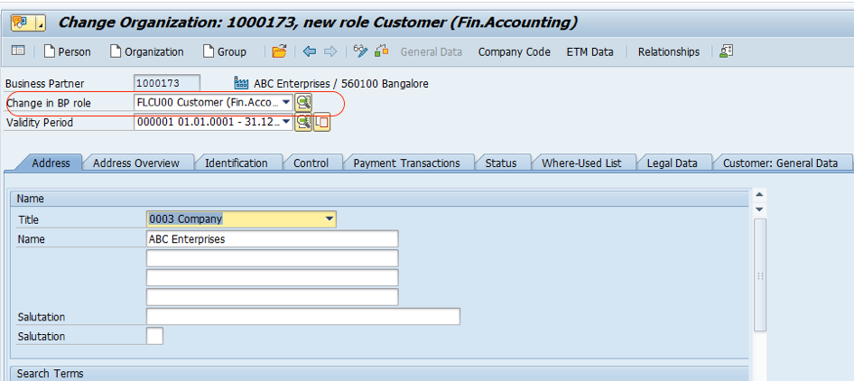
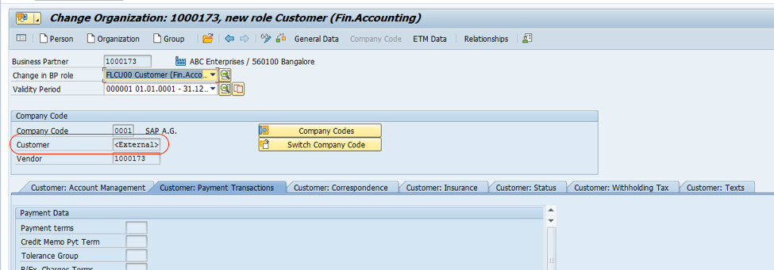
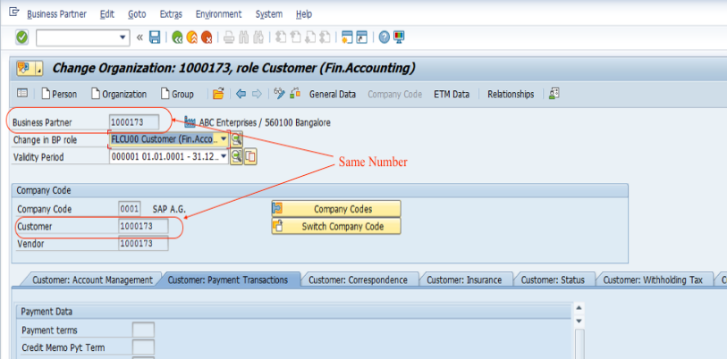
Extend BP to Customer Role FLCU00 for Financial Accounting
Click on Company code and enter all the mandatory fields and then save
Note: Here in the Company Code Section customer number is presented as <EXTERNAL>
After saving it will get updated same as BP number
Notes:
Fixar a posicao do titulo – sempre do lado esquerdo.
Sempre que tiver muito texto o coluna deve sempre ser “ narrowed” , se nao fica dificil de ler. Colocar paragrafos no texto.
Linha vertical deve ser mais fina e as pontas NUNCA devem ser arredondadas.

Slide 27
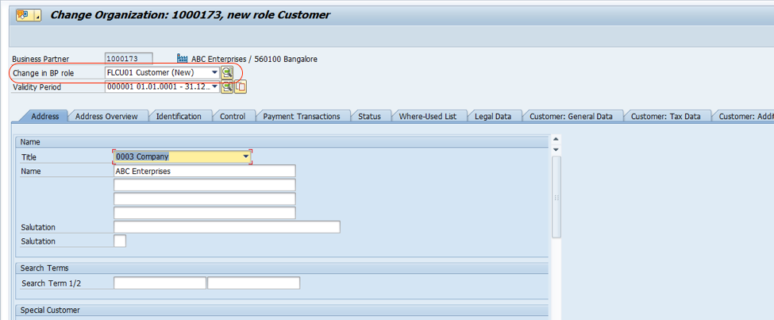
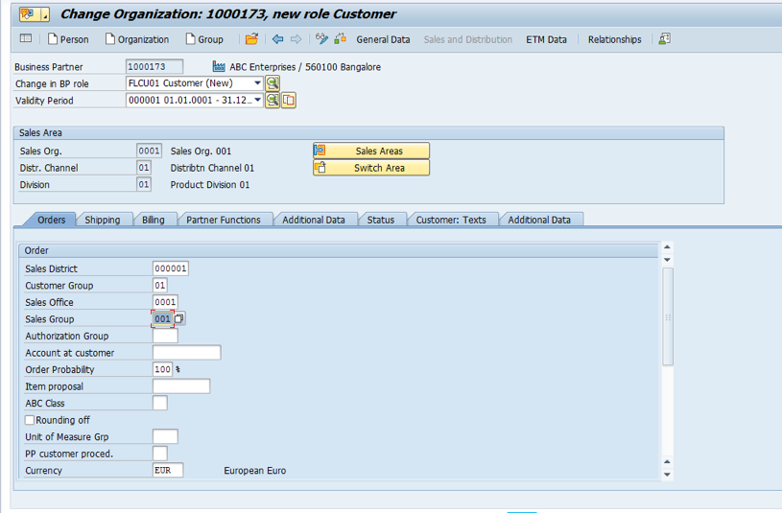
Extend Customer for Sales Data with Role FLCU01.
Press Sales and Distribution data button and fill all the mandatory fields

Slide 28
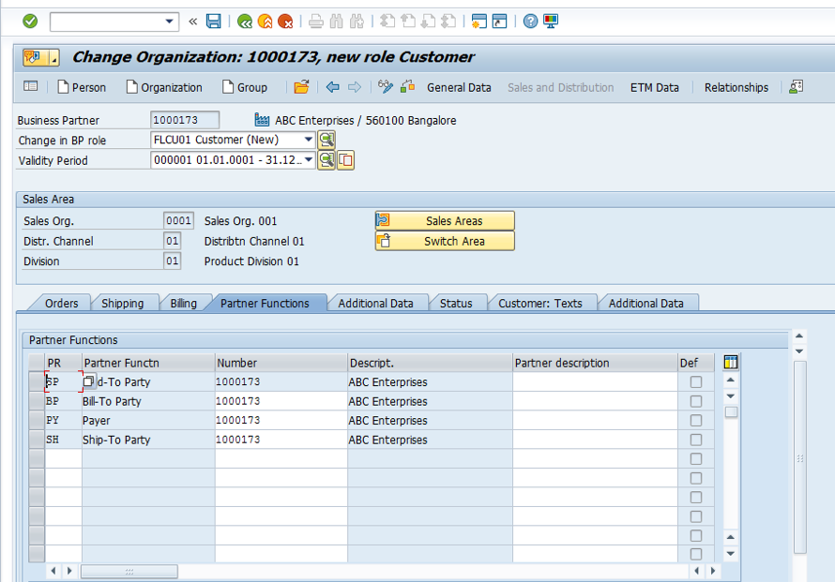
Business Partner: Customer
Notes:
In Condition Technique first step is to define condition type (if agreed condition with vendor is not standard exp vendor rebate on quantity basis instead of purchase value). Condition type control the basic characteristics of condition e.g whether condition is value based or quantity based. An access sequence is assigned to each condition type which is used to search valid condition record in condition table.
New condition type defined by copying existing condition type and changing the control parameter.

Slide 29
Customer Invoice Posting
You enter the general data for the posting document on the screen in the document header, for example, invoice date, posting date, reference, document header text, and so on. For entering invoice and credit memos received, you can define a document type for each transaction, which then appears as a general default value. SAP has provided standard document types for these transactions. However, we can configure and use different type of documents to meet special requirement of client
You can overwrite this proposed document type at any time as long as the document type field is ready for input during document entry
If you do not define a document type, the system proposes standard document types; for example, DR for posting customer invoices, DZ for receipts from customer
Notes:
Calculation schema is the group of condition type and there sequence used in price determination. Create new calculation schema by copying existing calculation schema if new condition type is created.

Slide 30
Enjoy Posting Screen: Additional Line Items
Enter the additional line items for the document in the table in the bottom section of the screen
The account name appears once you have made and confirmed your entries.
You can select different fields or columns and change the size and sequence of the columns and fields
You can also copy line items
At the top of the screen, you can select from park, post or hold, to complete the document entry transaction once the balance is zero

Slide 31
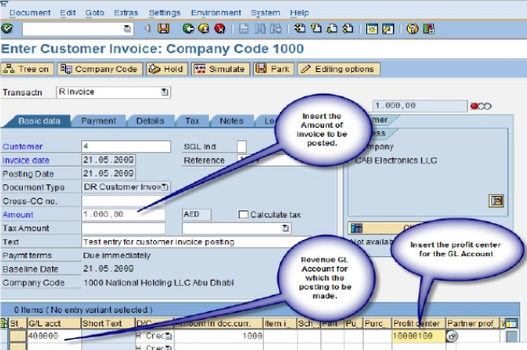
Post Customer Invoice Transaction Code FB70
Notes:
In partner determination schema permissible partner role with control indicator (exp mandatory) for rebate arrangement is defined. All partner role used in partner schema should be defined. Partner Schema is assigned to rebate arrangement type.

Slide 32
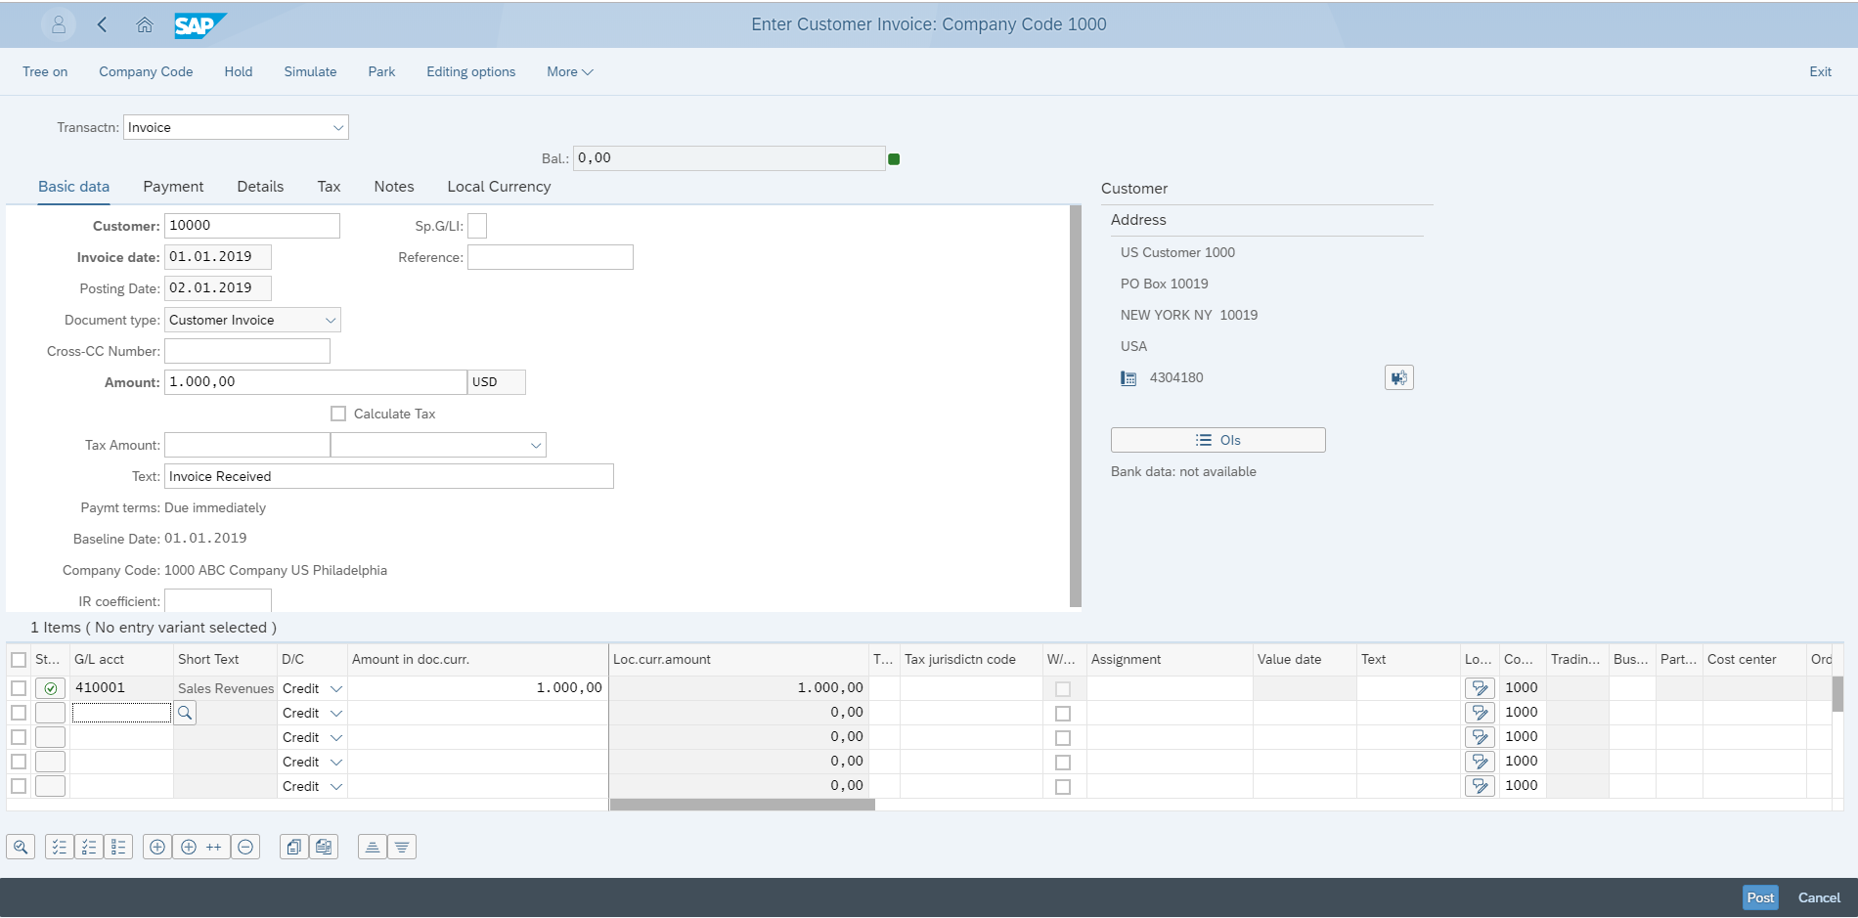
Create Outgoing Invoices
1. Select Customer ID
7. Check the status of the Document
2. Provide Invoice Date
3. Provide Posting Date
4. Give Invoice Amount
5. Give Respective GL Number
6. Provide Invoice Amount
8. Press Post Button
9.Successfully posted a Sales invoice

Slide 33
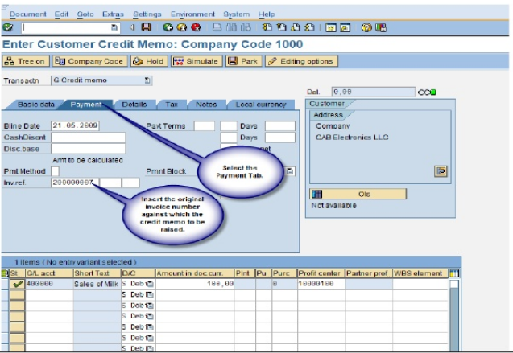
Post Customer Credit Memo Transaction Code FB75

Slide 34
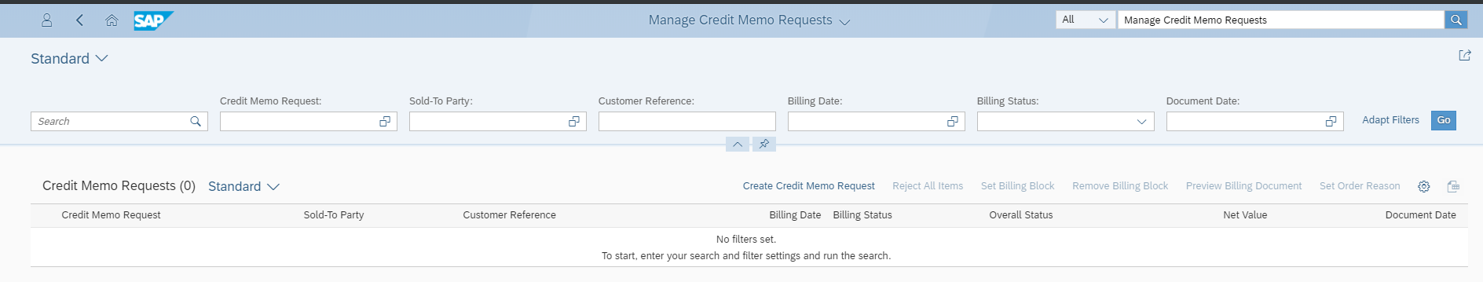
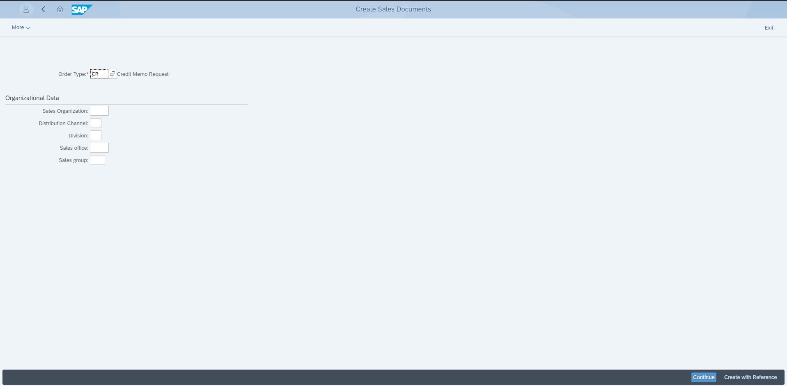
Manage Credit Memo Requests
1. Click Create Credit Memo request
2. Specify Order Type “CR”
3. Click Create with reference Button
Notes:
Create new rebate arrangement calendar if you want to settled periodic condition. Suppose you want to settled periodic condition quarterly than you need to define new rebate calendar.

Slide 35
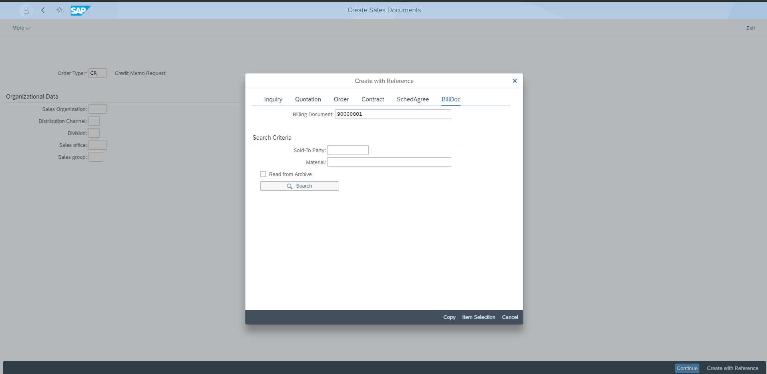
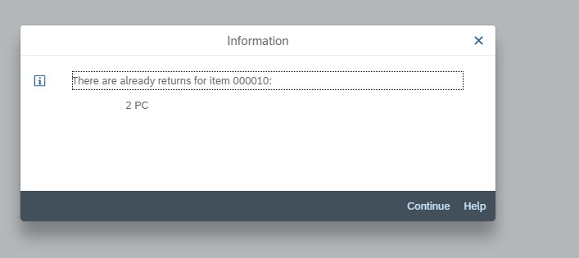
Manage Credit Memo Requests
4. Provide Billing Document Number
5. Click “Copy” Icon
6. Will get return message information
7. Click “Continue” Button
Notes:
Rebate Arrangement Type control following parameters:
Validity Start and Validity End Date: Default date when you create rebate arrangement of this type. If you choose different validity start and end date system will give warning message.
Arrangement Calendar: Control end of validity period of rebate arrangement. Validity end date is the final settlement date of rebate arrangement.
Time of Update: Whether business volume data will update at PO creation time or GR time or Invoice entry time
Final Settlement Indicator: If this indicator set final settlement is mandatory at end of rebate arrangement validity period
Settlement partner: Arrangement is for vendor or customer
Settlement Type: As the result of settlement accounting whether vendor credit memo or customer invoice generated.
Settlement Calendar: Settlement time of periodic condition

Slide 36
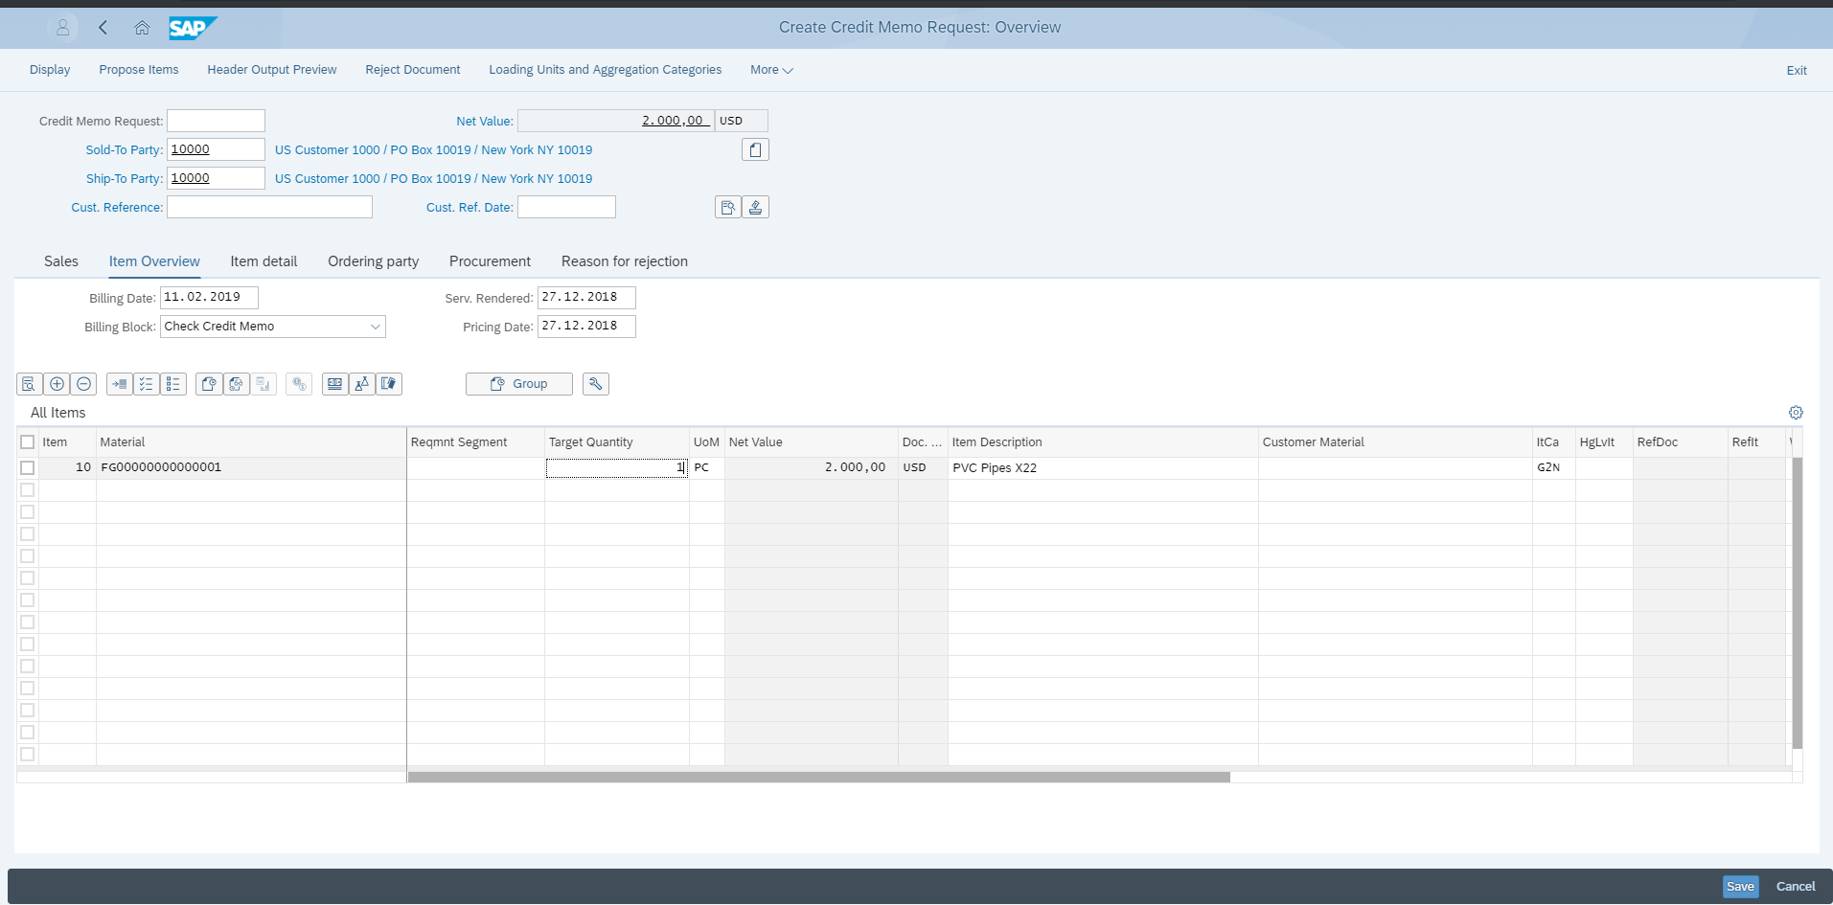
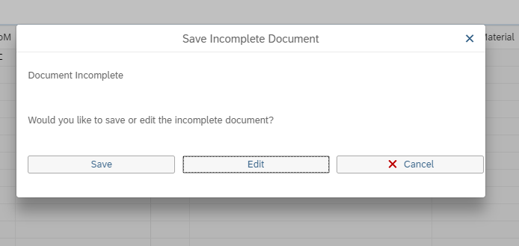
Manage Credit Memo
8. We will change target quantity PC
9. Click save Button
10. Click save Button
11. Successfully Credit Memo request generated

Slide 37
Process for Cash Receipts
cash receipt is recognized when an entity receives cash from any external source, such as a customer, an investor, or a bank. Typically, this cash is recognized when money is received from a customer to offset the AR balances generated when the sale transaction occurred

Slide 38
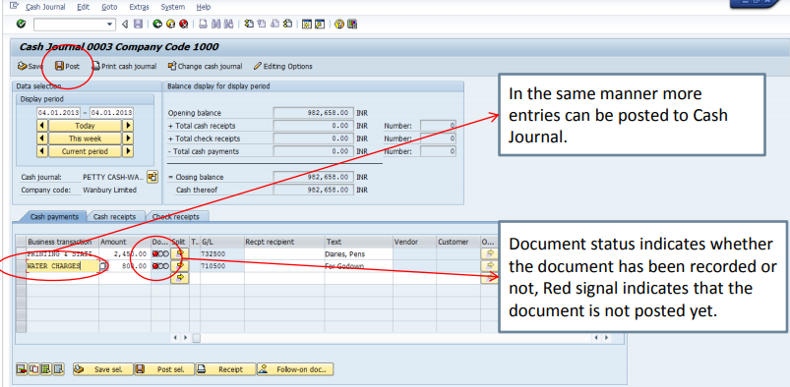
Cash Journal Posting

Slide 39
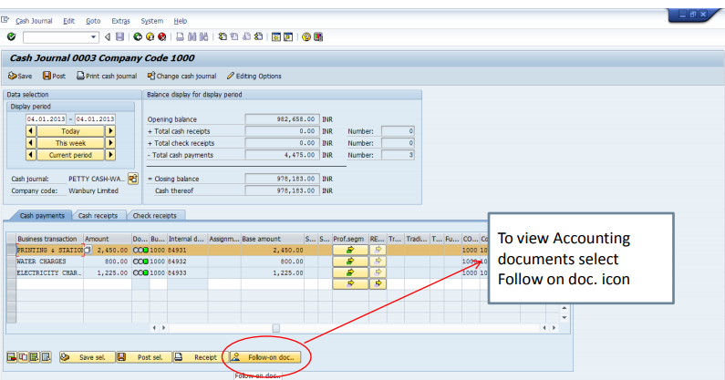
Notes:
Fixar a posicao do titulo – sempre do lado esquerdo.
Sempre que tiver muito texto o coluna deve sempre ser “ narrowed” , se nao fica dificil de ler. Colocar paragrafos no texto.
Linha vertical deve ser mais fina e as pontas NUNCA devem ser arredondadas.

Slide 40
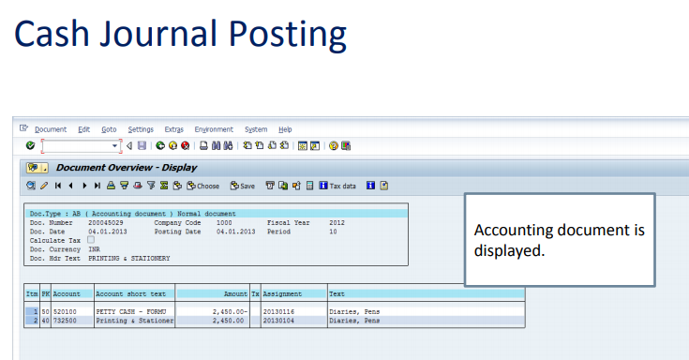
Cash Journal Posting

Slide 41
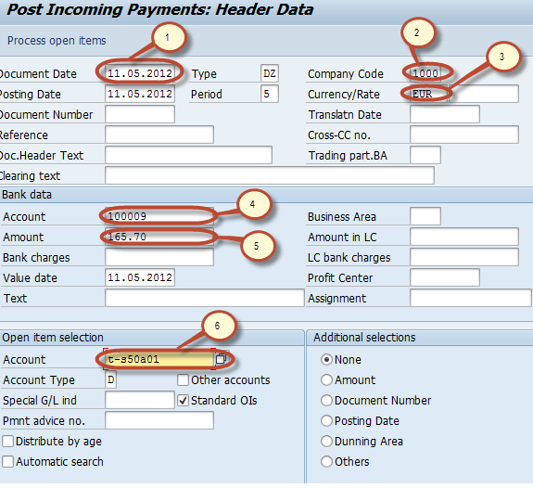
Customer Incoming Cash/ Bank Payments

Slide 42


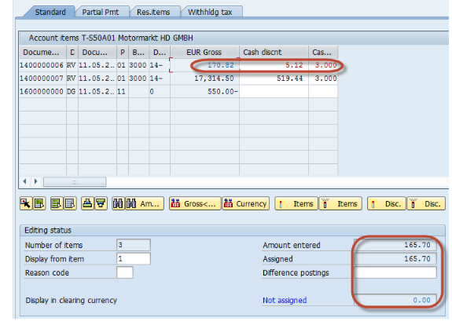

Post Incoming Payments
Notes:
Subsequent Settlement Indicator: This indicator means subsequent settlement is allowed for this vendor on that particular organization level
Subsequent Settlement Index: In case of retrospective rebate arrangement business volume done with vendor before creating rebate arrangement will be consider for settlement
Business Volume comparison: If you put this indicator then before final settlement or partial settlement business volume recorded by you and by vendor must be compared and both should be agreed on common business volume data.

